Slide 1
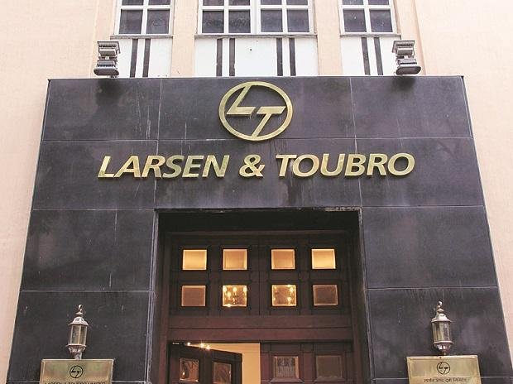
Operates in various sectors, including engineering, construction, manufacturing, information technology, and financial services.

Slide 2
Engineering
Defence
Space support

Slide 3
MARKETING MIX OF
L & T
Product: L&T provides a wide range of products and services across various industries, including engineering, construction, manufacturing, information technology, and financial services. Its products include heavy machinery, electrical and electronic equipment, defense equipment, and various infrastructure and construction projects. L&T also offers services such as IT solutions and financial services.
Price: L&T follows a competitive pricing strategy in the market. It considers the pricing strategies of its competitors, the cost of production, and the value that its products and services offer to the customers while setting the prices.
Place: L&T operates globally and has a strong presence in India. Its products and services are available through various channels such as direct sales, distribution networks, and online channels.
Promotion: L&T uses various promotional methods such as advertising, sales promotion, public relations, and personal selling to reach out to its customers. It also participates in various trade shows and exhibitions to showcase its products and services.

Slide 4
L & T PRODUCT LINE AND DEPTH
Product line
Product Depth
Engineering and Construction
Manufacturing
Information Technology
Financial Services
Electrical and Automation
Hydrocarbon
Engineering and Construction
Power plants
Oil and gas projects
Water treatment plants

Slide 5

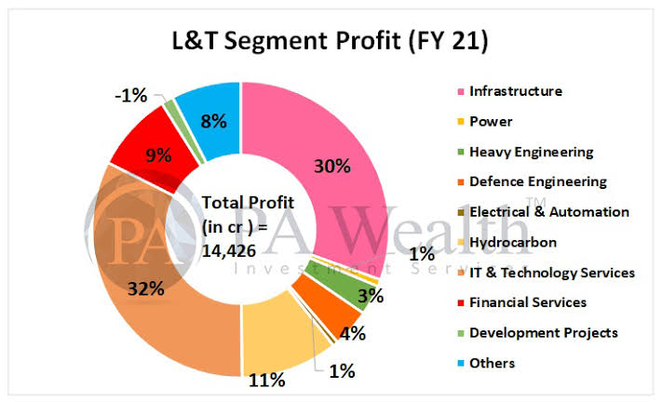
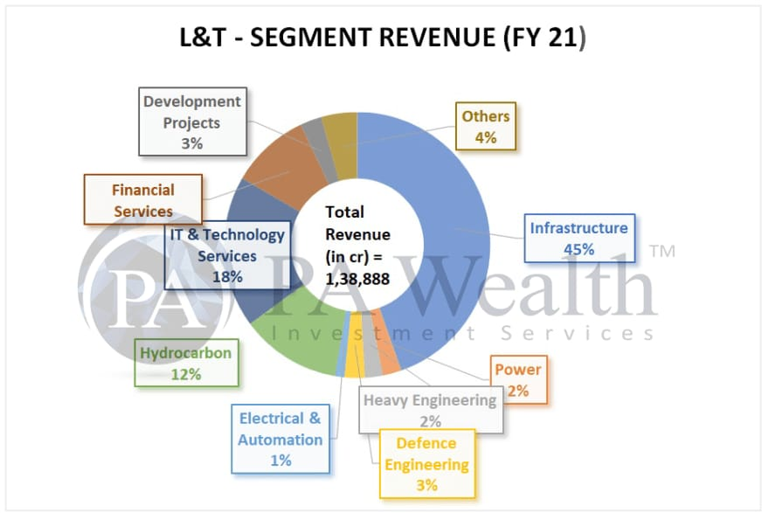
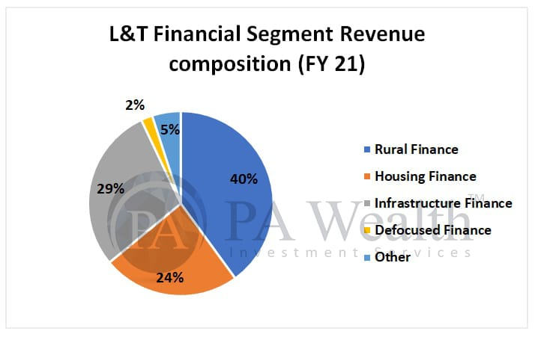
L& T ANALYSIS

Slide 6
INTERPRETATION
The company's IT division, L&T Infotech, has a strong presence in the IT services industry, providing application development and maintenance, testing and quality assurance, and infrastructure management services.
The company's IT division, L&T Infotech, has a strong presence in the IT services industry, providing application development and maintenance, testing and quality assurance, and infrastructure management services.
L&T's focus on innovation, quality, and customer-centricity has enabled it to maintain its position as a leading player in various markets. Its strong presence in the construction and engineering sector, as well as its diverse manufacturing capabilities, make it a key player in India's infrastructure development.
L&T's financial services division provides a range of financial products and services, including personal and business loans, wealth management services, and insurance.
Overall, L&T's diverse product range, strong focus on innovation and quality, and complex organizational structure make it a significant player in various markets in India and around the world.

Slide 7
THANK YOU
Company Name- LARSEN & TUOBRO (L&T)
Subject- Marketing Management
NAME – Akshay Chandrakant Katruwar A - OSCM (03)

